Slide 1


GAME ANALYTICS
UNLOCKING TENNIS DATA WITH SPORTRADAR API
An End-to-End Data Engineering & Analysis Project
Team Analytics: Bhumika Chouhan, Yash solanki
Kritika Kature, Parv Goyal
January 2026

Slide 2


PROJECT OBJECTIVE
THE PROBLEM
OUR SOLUTION
Tennis data is historically fragmented, expensive, and difficult to access in a structured format. Analysts often struggle with nested JSON feeds and lack a centralized "Source of Truth" for global tournaments, especially below the ATP/WTA tier.
We engineered an end-to-end automated data pipeline. By ingesting raw API data, normalizing it into a relational SQL database, and visualizing it via Streamlit, we created a robust system for strategic analysis of the global tennis ecosystem.

Slide 3





TEAM COMPOSITION
DATA ENGINEER
DATABASE ARCHITECT
DATA ANALYST
FRONTEND DEV
API Integration Specialist. Handled authentication, raw JSON extraction, data flattening, and rate-limiting scripts.
Developed complex SQL queries to uncover trends in player efficiency, venue distribution, and tour structure.
Built the Streamlit dashboard to visualize key metrics and provide an interactive user interface.
Designed the normalized SQL structure (3NF), enforced referential integrity, and managed data loading.

Slide 4
TECHNOLOGY STACK
Python (Pandas/Requests)
Used for ETL: Extraction, Transformation, and Loading.
SportRadar API
The primary source for real-time and historical tennis data.
SQL (Relational DB)
Structured storage with enforced primary/foreign keys.
Streamlit
Rapid application development for data visualization.

Slide 5




DATA PIPELINE ARCHITECTURE
1. INGESTION
2. PROCESSING
3. STORAGE
4. ANALYTICS
Python scripts fetch JSON from Competitions, Complexes, and Rankings endpoints.
Pandas `explode()`functions flatten nested lists (e.g., venues inside complexes).
Cleaned CSVs are loaded into SQL tables: Competitions, Venues, Players.
SQL queries drive the Streamlit dashboard for real-time insights.

Slide 6




DATA QUALITY & VALIDATION AUDIT
100% INTEGRITY
ZERO DUPLICATES
EXTENSIVE COVERAGE
COMPLETENESS
Passed. No "Orphan" records found. Every venue links to a complex; every ranking links to a player.
Passed. All critical fields (Names, IDs, Points, Country Codes) are present and valid.
Passed. 0 Duplicates found in Primary Keys across all tables after ingestion.
6,428 Competitions
3,803 Venues
1,000+ Ranked Players

Slide 7
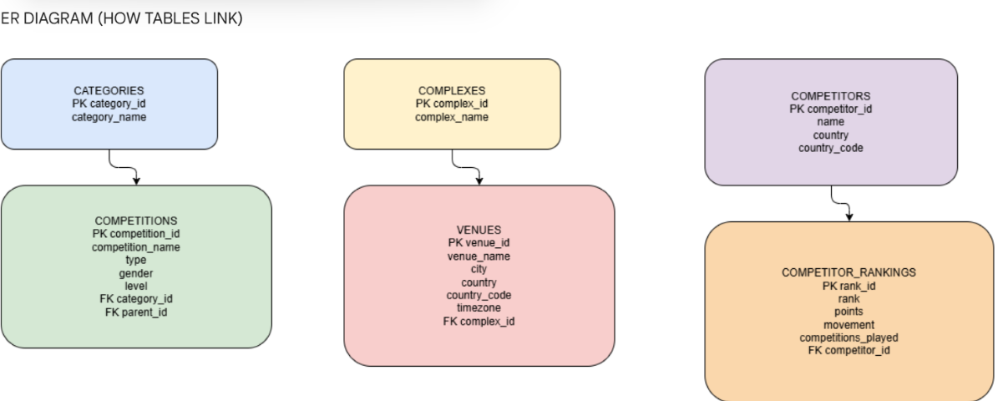
NORMALIZED DATABASE SCHEMA
NORMALIZED DATABASE SCHEMA
DESIGN PHILOSOPHY
We adopted a 3rd Normal Form (3NF) approach to eliminate redundancy. For example, 'Category' information is stored once and referenced by ID in the 'Competitions' table.
Table: Competitions (Linked to Categories)
Table: Venues (Linked to Complexes)
Table: Rankings (Linked to Competitors)
Table: Rankings (Linked to Competitors)

Slide 8
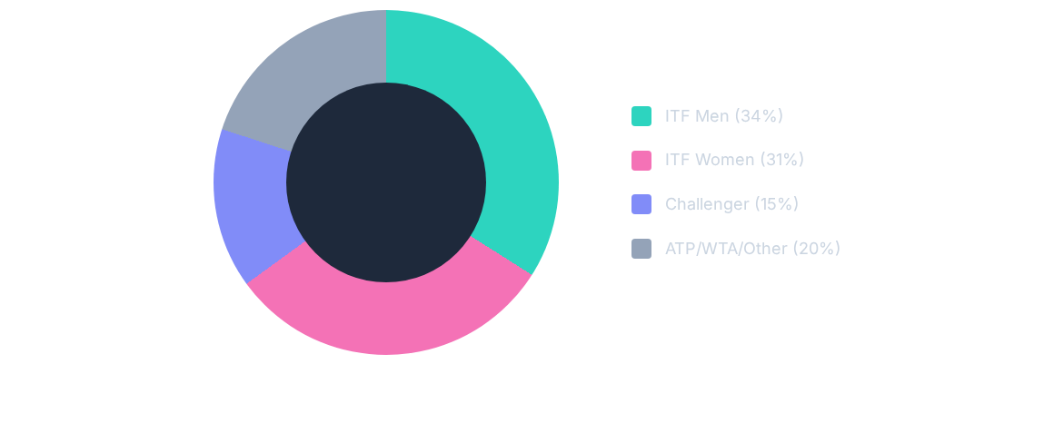
INSIGHT 1: THE "ENGINE ROOM" OF TENNIS
Contrary to TV coverage, 65% of all competitions occur at the ITF level. Predictive models must focus here.

Slide 9
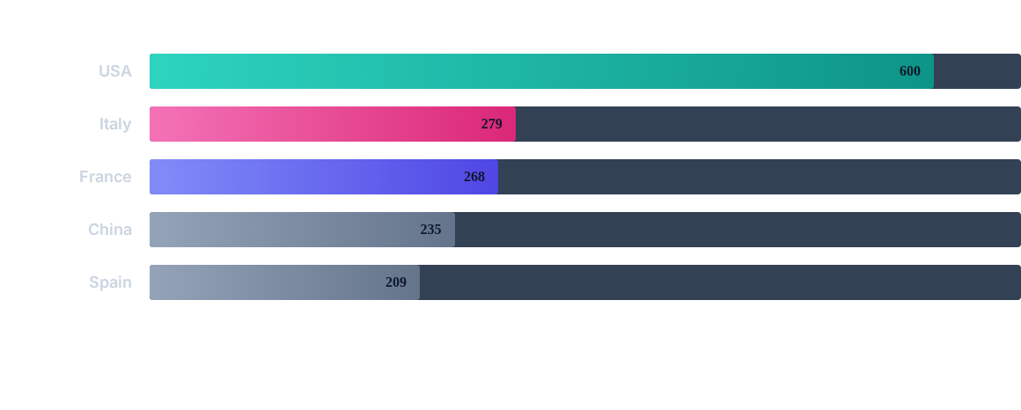
INSIGHT 2: GLOBAL INFRASTRUCTURE HEGEMONY
The USA possesses more than 2x the recorded tennis venues of any other nation.

Slide 10

THE GREAT BRITAIN ANOMALY
DOUBLES DOMINANCE
Our analysis of the Doubles Rankings revealed a striking trend. Three of the Top 4 ranked doubles players in our dataset are British.
This statistical anomaly suggests a highly specialized and successful doubles training program within the UK system, differentiating it from the singles-focused strategies of other major federations.

Slide 11



FUTURE SCOPE & ROADMAP
PREDICTIVE MODELING
LIVE DATA INGESTION
MOBILE OPTIMIZATION
Utilize historical ranking data and surface preferences (clay vs. grass) to train Machine Learning models for match outcome prediction.
Upgrade the pipeline to handle the "Live Summaries" endpoint, enabling point-by-point analysis and momentum tracking.
Refactor the Streamlit dashboard into a progressive web app (PWA) for scouts and coaches to use courtside.

Slide 12
QUESTIONS?
Thank You for your attention.
Project Repository: github.com/your-repo | Contact: analytics-team@project.com

